Slide 1
The waterfall
The waterfall

Slide 2
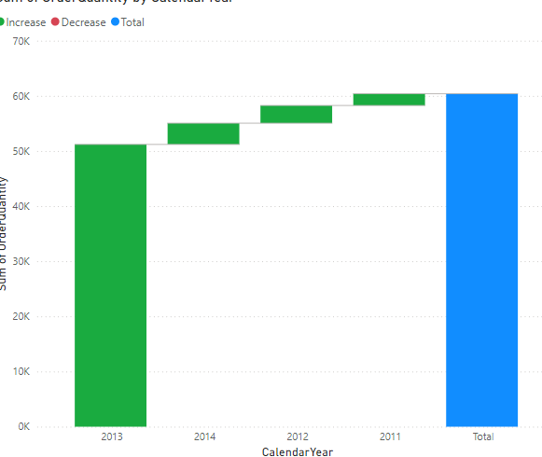
The waterfall
Add a waterfall to the scene and try to represent the amount of sales by adding it to the Y axis and the calendar year from DimDate in the category

Slide 3
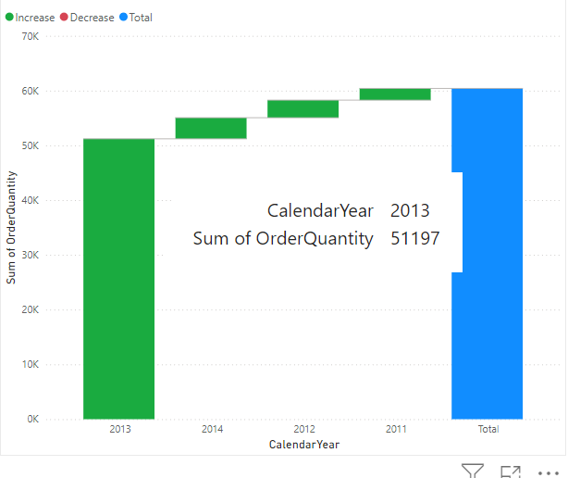
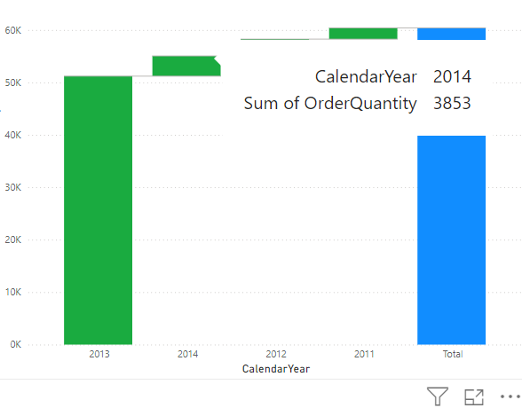
The waterfall
To try hovering over the rectangles, there are two categories of rectangles , there are worms and there are East only one who East blue and that represents the total

Slide 4
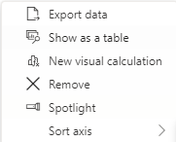
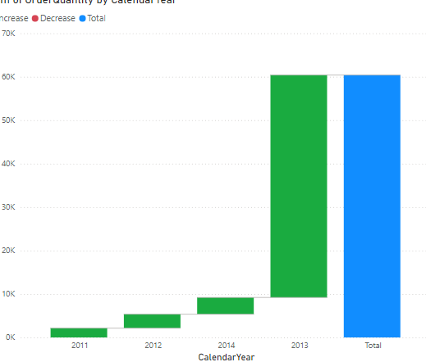
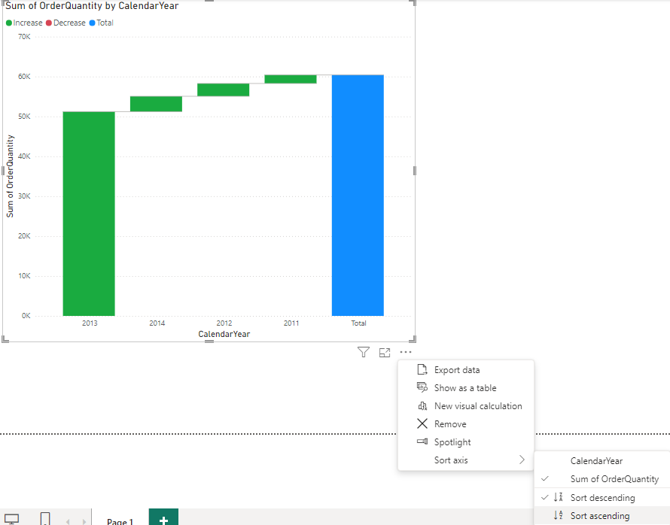

The waterfall
Click on More options and change the order of the years, then the quantities sold

Slide 5
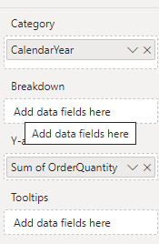
The waterfall
Note the presence of the Breakdown parameter in the fields section

Slide 6
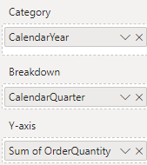
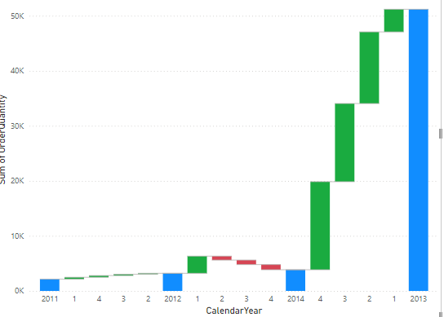
The waterfall
Add the CalendarQuarter from DimDate has the Breakdown parameter and note each quarter's contribution to sales growth

Slide 7
The waterfall
If there is depreciation, the color of the rectangles turns red.
Replacement schedule Quarter with CalendarSemester and try to analyze the data

Slide 8
Thank you
Thank you

